Slide 1
Regular Expressions
Düzenli/kurallı ifadeler
https://docs.python.org/3/library/re.html
w3resource.com/python-regular-expression
w3schools.com/python_regex
https://regex101.com/
erdincdonmez.com

Slide 2
Regular Expression (Düzenli yada kurallı ifadeler)
Düzenli veya kurallı ifade, bir metindeki katarların(karakter veya kelime dizisi) belli bir düzen içinde (belli bir kalıpta) olup olmadığını kontrol etmek için kullanılır. Bu katarlar belli karakterler, kelimeler veya karakter örüntüleri olabilir.
Bu konuda, verilen metne bakıp verilen tarife uygun kısımlarını belirleyip, duruma göre bir şey yapacağız.
tr.wikipedia.org/Düzenli_ifade
Düzenli ifadeler ile yapabileceklerimize bir kaç örnek.
Uzun bir metindeki Ankara ifadelerini Angara olarak değiştirebiliriz.
adam kelimesinden önce geçen büyük kelimelerini güçlü kelimesiyle değiştirebiliriz.
Sayılardan sonra gelen YTL ifadelerini TL ile değiştirebiliriz.
Bir metindeki noktalama işaretlerini kaldırabiliriz.
HTML taglarını bulabilirriz.
re.findall() ile stringleri eşleştirebiliriz.
harf/kelime gruplarını karşılaştırabiliriz
Non capturing group
Back Reference
Named Grouping (?P<name>)
Substitute String
Look around
Match common username or password
Match hex color value
Match email
Match URL
Match IP address
Match Mac address
Lexer

Slide 3
import re
metin1 = "Bugün hava çok soğuk"
metin2 = "Bursa çok sıcak"
metin3 = "Bugün hava soğuk."
aranan = "^Bu.*sıcak$" # Başında Bu olan ve sıcak ile biten
print(re.search(aranan, metin1))
print(re.search(aranan, metin2))
print(re.search(aranan, metin3))
https://regex101.com/
https://regexr.com/
aranan yerine aşağıdakileri yazabilirsiniz.
\d rakam
\d\d\d üç rakam
\d{5} beş rakam
\D rakam olmayan karakter
\D\D\D rakam olmayan üç karakter
\(\D{7}\) rakam olmayan (qwertyu) gibi 7 haneli karakterler
. tüm karakterler
\. noktalar
\d{3}\d{7}|\(\d{3}\)\d{7}|\d{3}-\d{7} (507)9438357 5537867453 3
505-8562147 şeklindeki numaralar
[a-z0-9A-Z_]*@[a-z0-9A-Z]*\.[a-zA-Z]* mail adresleri
sipariş[^\d]*(\d*) başında sipariş yazıp sonrasında numara olanlar.

Slide 4
Meta karakterler ve Özel Diziler
Özel anlamlı karakterler:
Açıklama Örnek
[] Bir karakter grubu "[a-k]"
\ Özel bir diziyi ifade eder. Özel karakterlerden kaçınmak için de kullanılır "\d"
. herhangi bir karakter (yeni satır karakteri hariç) "he..o"
^ … ile başlayan "^hello"
$ … ile biten "planet$"
* Sıfırdan çok "he.*o"
+ Birden çok "he.+o"
? Sıfır veya birden fazla "he.?o"
{} Belirtilen sayıda "he.{2}o"
| İkisinden biri "falls|stays"
() Capture and group
Özel bir diziler: \ işaretinin ardından aşağıdaki karakterlerden biri gelirse özel bir anlam ifade eder.
Açıklama Örnek
\A Başında … varsa getir. "\AThe"
\b r"\bain" … var ama kelimenin başında ve sonunda. (Başlangıçtaki "r", dizenin "ham dize" olarak değerlendirildiğinden emin olmaktır) r"ain\b"
\B r"\Bain" … var ama kelimenin başında ve sonunda değil. Başlangıçtaki "r", dizenin "ham dize" olarak değerlendirildiğinden emin olmaktır) r"\Bain" r"ain\B"
\d 0-9 arası sayılar içerenler "\d"
\D 0-9 arası sayılar içermeyenler "\D"
\s Boşluk karakteri içerir "\s"
\S Boşluk içermeyen "\S"
\w a-Z, 0-9 veya _ karakteri içerenler "\w"
\W a-Z, 0-9 veya _ karakteri içermeyenler "\W"
\Z … sonundaysa getir "Spain\Z"

Slide 5
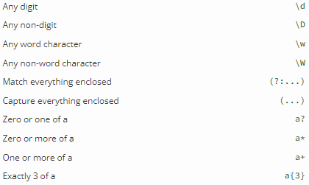
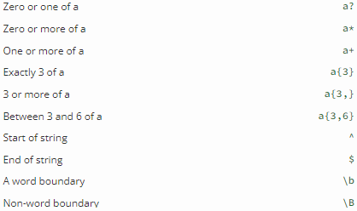
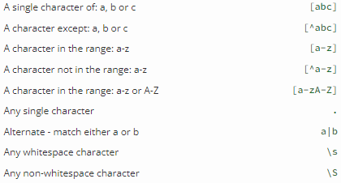
Setler
[]Küme, bir çift köşeli parantez içindeki özel bir anlamı olan bir karakter kümesidir :
[Ali] A, l veya i karakterlerinden biri
[^Ali] A,l,i karakterlerinden başkaları
[^arn] a, r ve n DIŞINDAKİ karakterler
[a-z] küçük harfler
[a-n] a ile n arasında küçük harfler
[^a-z] küçük haflerden başkaları
[a-zA-Z] harfler
[.] tek karakter
a|b a veya b
\s boşluk (white space)
\S Any non-white space chars
[0123] 0, 1, 2 veya 3 karakterlerinden biri
[0-9] 0 ile 9 arasındaki herhangi bir rakam
[0-5][0-9] 00 ile 59 arasındaki iki basamaklı sayılar
[a-zA-Z] büyük veya küçük harfler
[+] Kümeler halinde, +, *, ., |, (), $,{}'nin özel bir anlamı yoktur, dolayısıyla [+] şu anlama gelir: dizedeki herhangi bir + karakteri için bir eşleşme döndür

Slide 6
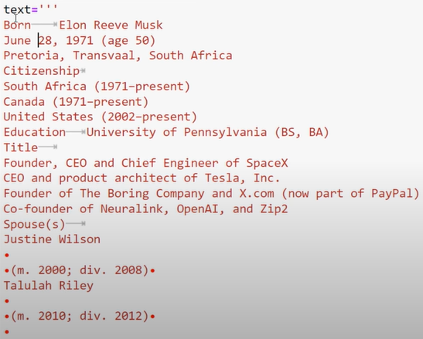
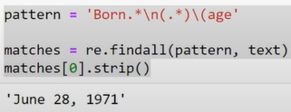
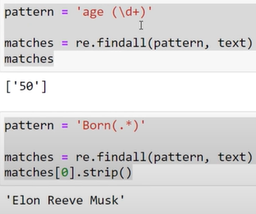
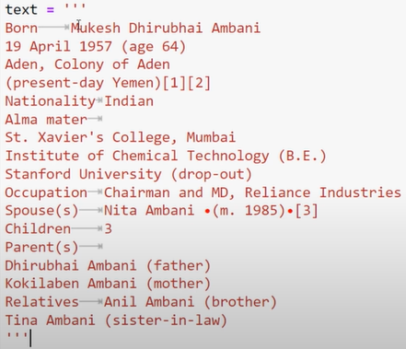
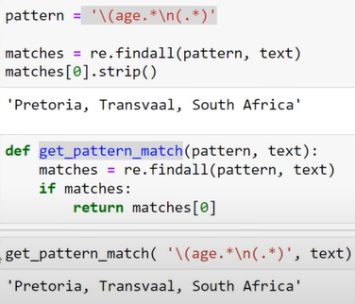
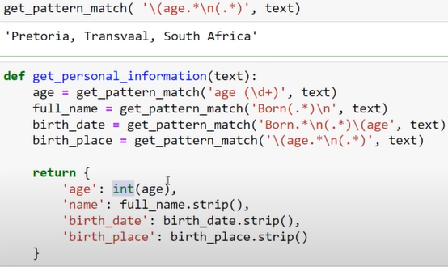
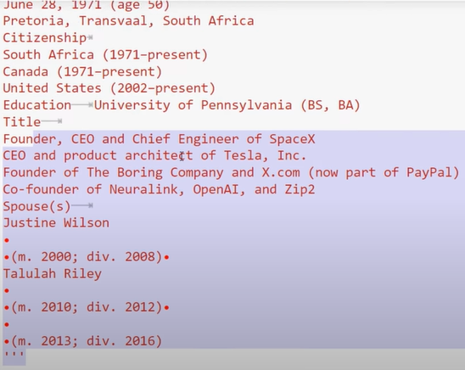
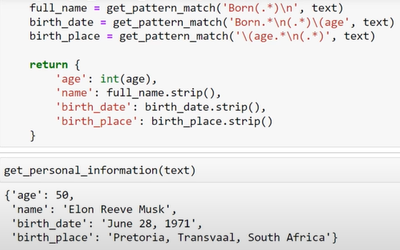
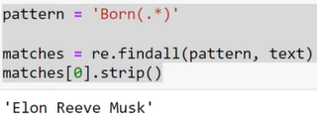
Örnek : https://youtu.be/codebasic/Regex For NLP

Slide 7
re fonksiyonları
# ör-1: findall ile metin içindekileri alma
import re
txt1 = "Ahmet al renkli bir şal aldı."
txt2 = "Mehmet kırmızı bir top getirdi."
print(re.findall("al", txt1))
print(re.findall("al", txt2))
# ör-2: search ile metin içinde arama
import re
txt = "Ahmet al renkli bir şal aldı."
aa = re.search("\s", txt)
print("İlk boşluğun bulunduğu yer:", aa.start())
bb = re.search("Mehmet", txt); print(bb)
print(re.search("şal", txt))
# ör-3 split ile metni bölme
import re
xxx = "Ahmet al renkli bir şal aldı."
print(re.split("\s", xxx)) # Boşluğa göre böl
print(re.split(" ", xxx)) # Boşluğa göre böl
print(re.split("a", xxx)) # a ya göre böl
print(re.split("al", xxx)) # al a göre böl
print(re.split(" ", xxx,3)) # 3.boşluk dahil böl
# ör-4 sub ile değiştirme
import re; txt = "Ahmet al renkli bir şal aldı."
print(re.sub("\s", "x", txt)) # Boşlukları x yap
print(re.sub(" ", "_", txt)) # Boşlukları _ yap
print(re.sub(" ", " ", txt)) # Boşlukları 3 boşluk yap
print(re.sub("al", "red", txt)) # al ları red yap
findall Tüm eşleşmeler listesi
search Ara
split Böl
sub Uyuşanları değiştir
import re
xxx = "Ahmet al renkli bir şal aldı."
# tüm al ifadelerinin listesi
print(re.findall("al", xxx))
# şal ifadesini ara
print(re.search("şal", xxx))
# “al” a göre böl
print(re.split("al", xxx))
# Boşlukları zzz yap
print(re.sub(" ", "zzz", xxx))

Slide 8
regular expressions özel karakterleri (geniş liste)
Special characters Description
. (Dot.) In the default mode, this matches any character except a newline. If the DOTALL flag has been specified, this matches any character including a newline.
^ (Caret.) Matches the beginning of the string or line. For example /^A/ does not match the 'A' in "about Articles" but does match it in "Articles of life"
$ Matches the end of the string or line. For example, /e$/ does not match the 't' in "exact", but does match it in "w3resource".
* Matches the previous character 0 or more times. For example, /bo*/ matches 'boo' in "A bootable usb" and 'b' in "A beautiful mind", but nothing in "A going concern".
+ Matches the previous character 1 or more times. For example, /a+/ matches the 'a' in "Daniel" and all the a's in "Daaam"
? Matches the previous character 0 or 1 time. For example, /r?eu?/ matches the 're' in "w3resource" and the 'eu' in "europe".
*?, +?, ?? The '*', '+', and '?' qualifiers are all greedy; they match as much text as possible. Sometimes this behaviour isn’t desired; if the RE <.*> is matched against '<a> b <c>', it will match the entire string, and not just '<a>'. Adding ? after the qualifier makes it perform the match in non-greedy or minimal fashion; as few characters as possible will be matched. Using the RE <.*?> will match only '<a>'.
{m} Specifies that exactly m copies of the previous RE should be matched; fewer matches cause the entire RE not to match. For example, b{5} will match exactly five 'b' characters, but not four.
{m,n} Causes the resulting RE to match from m to n repetitions of the preceding RE. For example, a{2,5} will match from 2 to 5 'a' characters. Omitting m specifies a lower bound of zero, and omitting n specifies an infinite upper bound. As an example, a{4,}b will match 'aaaab' or a thousand 'a' characters followed by a 'b', but not 'aaab'.
{m,n}? Causes the resulting RE to match from m to n repetitions of the preceding RE, attempting to match as few repetitions as possible. This is the non-greedy version of the previous qualifier. For example, on the 6-character string 'aaaaaa', a{3,5} will match 5 'a' characters, while a{3,5}? will only match 3 characters.
\
Either escapes special characters (permitting you to match characters like '*', '?', and so forth), or signals a special sequence; special sequences are discussed below.
[] Used to indicate a set of characters. In a set:
Characters can be listed individually, e.g. [amk] will match 'a', 'm', or 'k'.
Ranges of characters can be indicated by giving two characters and separating them by a '-', for example [a-z] will match any lowercase ASCII letter, [0-5][0-9] will match all the two-digits numbers from 00 to 59, and [0-9A-Fa-f] will match any hexadecimal digit. If - is escaped (e.g. [a\-z]) or if it’s placed as the first or last character (e.g. [-a] or [a-]), it will match a literal '-'.
Special characters lose their special meaning inside sets. For example, [(+*)] will match any of the literal characters '(', '+', '*', or ')'.
Character classes such as \w or \S (defined below) are also accepted inside a set, although the characters they match depends on whether ASCII or LOCALE mode is in force.
Characters that are not within a range can be matched by complementing the set. If the first character of the set is '^', all the characters that are not in the set will be matched. For example, [^5] will match any character except '5', and [^^] will match any character except '^'. ^ has no special meaning if it’s not the first character in the set.
To match a literal ']' inside a set, precede it with a backslash, or place it at the beginning of the set. For example, both [()[\]{}] and []()[{}] will both match a parenthesis.
| A|B, where A and B can be arbitrary REs, creates a regular expression that will match either A or B. An arbitrary number of REs can be separated by the '|' in this way. This can be used inside groups (see below) as well.
(...) Matches whatever regular expression is inside the parentheses, and indicates the start and end of a group; the contents of a group can be retrieved after a match has been performed, and can be matched later in the string with the \number special sequence, described below. To match the literals '(' or ')', use \( or \), or enclose them inside a character class: [(], [)].
(?...) This is an extension notation (a '?' following a '(' is not meaningful otherwise). The first character after the '?' determines what the meaning and further syntax of the construct is. Extensions usually do not create a new group; (?P<name>...) is the only exception to this rule. Following are the currently supported extensions.
(?aiLmsux) (One or more letters from the set 'a', 'i', 'L', 'm', 's', 'u', 'x'.) The group matches the empty string; the letters set the corresponding flags: re.A (ASCII-only matching), re.I (ignore case), re.L (locale dependent), re.M (multi-line), re.S (dot matches all), re.U (Unicode matching), and re.X (verbose), for the entire regular expression.
(?:...) A non-capturing version of regular parentheses. Matches whatever regular expression is inside the parentheses, but the substring matched by the group cannot be retrieved after performing a match or referenced later in the pattern.
(?imsx-imsx:...) (Zero or more letters from the set 'i', 'm', 's', 'x', optionally followed by '-' followed by one or more letters from the same set.) The letters set or removes the corresponding flags: re.I (ignore case), re.M (multi-line), re.S (dot matches all), and re.X (verbose), for the part of the expression.
(?P<name>...)
Similar to regular parentheses, but the substring matched by the group is accessible via the symbolic group name name. Group names must be valid Python identifiers, and each group name must be defined only once within a regular expression. A symbolic group is also a numbered group, just as if the group were not named.
Named groups can be referenced in three contexts. If the pattern is (?P<quote>['"]).*?(?P=quote) (i.e. matching a string quoted with either single or double quotes):
Context of reference to group “quote” Ways to reference it
in the same pattern itself
(?P=quote) (as shown)
\1
when processing match object m
m.group('quote')
m.end('quote') (etc.)
in a string passed to the repl argument of re.sub()
\g<quote>
\g<1>
\1
(?P=name) A backreference to a named group; it matches whatever text was matched by the earlier group named name.
(?#...) A comment; the contents of the parentheses are simply ignored.
(?=...) Matches if ... matches next, but doesn’t consume any of the string. This is called a lookahead assertion. For example, Isaac (?=Asimov) will match 'Isaac ' only if it’s followed by 'Asimov'.
(?!...) Matches if ... doesn’t match next. This is a negative lookahead assertion. For example, Isaac (?!Asimov) will match 'Isaac ' only if it’s not followed by 'Asimov'.
(?<=...)
Matches if the current position in the string is preceded by a match for ... that ends at the current position. This is called a positive lookbehind assertion. (?<=abc)def will find a match in 'abcdef', since the lookbehind will back up 3 characters and check if the contained pattern matches.
>>> import re
>>> m = re.search('(?<=abc)def', 'abcdef')
>>> m.group(0)
'def'
This example looks for a word following a hyphen:
>>> m = re.search(r'(?<=-)\w+', 'spam-egg')
>>> m.group(0)
'egg'
(?<!...) Matches if the current position in the string is not preceded by a match for .... This is called a negative lookbehind assertion. Similar to positive lookbehind assertions, the contained pattern must only match strings of some fixed length. Patterns which start with negative lookbehind assertions may match at the beginning of the string being searched.
(?(id/name)yes-pattern|no-pattern) Will try to match with yes-pattern if the group with given id or name exists, and with no-pattern if it doesn’t. no-pattern is optional and can be omitted. For example, (<)?(\w+@\w+(?:\.\w+)+)(?(1)>|$) is a poor email matching pattern, which will match with '<user@host.com>' as well as 'user@host.com', but not with '<user@host.com' nor 'user@host.com>'. The special sequences consist of '\' and a character from the list below. If the ordinary character is not an ASCII digit or an ASCII letter, then the resulting RE will match the second character. For example, \$ matches the character '$'.
\number Matches the contents of the group of the same number. Groups are numbered starting from 1. For example, (.+) \1 matches 'the the' or '55 55', but not 'thethe' (note the space after the group). This special sequence can only be used to match one of the first 99 groups. If the first digit of number is 0, or number is 3 octal digits long, it will not be interpreted as a group match, but as the character with octal value number. Inside the '[' and ']' of a character class, all numeric escapes are treated as characters.
\A Matches only at the start of the string.
\b
Matches the empty string, but only at the beginning or end of a word. A word is defined as a sequence of word characters.
\B Matches the empty string, but only when it is not at the beginning or end of a word. This means that r'py\B' matches 'python', 'py3', 'py2', but not 'py', 'py.', or 'py!'. \B is just the opposite of \b, so word characters in Unicode patterns are Unicode alphanumerics or the underscore, although this can be changed by using the ASCII flag. Word boundaries are determined by the current locale if the LOCALE flag is used.
\d
Matches any character which is a digit. Equivalent to [0-9]. For example, /\d/ or /[0-9]/ matches '2' in "E2 means second example."
\D Matches any character which is not a decimal digit. This is the opposite of \d. If the ASCII flag is used this becomes the equivalent of [^0-9] (but the flag affects the entire regular expression, so in such cases using an explicit [^0-9] may be a better choice).
\s
Matches any white space character (including tab, new line, carriage return, form feed, vertical tab). [ \t\n\r\f\v].
For example, /\s\w*/ matches ' apple' in "An apple."
Matches characters considered whitespace in the ASCII character set; this is equivalent to [ \t\n\r\f\v].
\S Matches any character which is not a whitespace character. This is the opposite of \s. If the ASCII flag is used this becomes the equivalent of [^ \t\n\r\f\v] (but the flag affects the entire regular expression, so in such cases using an explicit [^ \t\n\r\f\v] may be a better choice).
\w
Matches characters considered alphanumeric in the ASCII character set; this is equivalent to [a-zA-Z0-9_]. If the LOCALE flag is used, matches characters considered alphanumeric in the current locale and the underscore.
\W
Matches any non-word character, equivalent to [^A-Za-z0-9_]. For example, /\W/ or /[^$A-Za-z0-9_]/ matches '$' in "150$"
\Z Matches only at the end of the string.

Slide 9
Compare HTML tags :
# open tag
>>> import re
>>> re.search('<[^/>][^>]*>', '<table>') != None
True
>>> import re
>>> re.search('<[^/>][^>]*>', '<a href="#label">') != None
True
>>> import re
>>> re.search('<[^/>][^>]*>', '<img src="/img">') != None
True
>>> import re
>>> re.search('<[^/>][^>]*>', '</table>') != None
False
# close tag
>>> import re
>>> re.search('</[^>]+>', '</table>') != None
True
# self close
>>> import re
>>> re.search('<[^/>]+/>', '<br />') != None
True
tag type format example
open tag <[^/>][^>]*> <a>, <table>
close tag </[^>]+> </p>, </a>
self close <[^/>]+/> <br />
all tag <[^>]+> <br />, <a>

Slide 10
Örnekler
Match nesnesi, arama ve sonuç hakkında bilgi almak için kullanılan özelliklere ve yöntemlere sahiptir:
.span() eşleşmenin başlangıç ​​ve bitiş konumlarını içeren bir tanımlama grubu döndürür.
.string işleve iletilen dizeyi döndürür,
.group() dizenin eşleşme olan kısmını döndürür
# search işlemi
import re
txt = "Ahmet al renkli bir şal aldı."
x = re.search("al", txt)
print(x) # al ifadesi için dönüş nesnesi
print(x.span()) # al ifadesinin yeri
print(x.span()[0]) # al ifadesinin başı
a = re.search(r"\bş\w+", txt) # ş harfiyle başlayan bir kelime
print(a.span())
x = re.search(r"\bş\w+", txt) # ş ile başlıyorsa al.
print(x.string)
x = re.search(r"\bş\w+", txt) # ş ile başlayan kelimeyi al.
print(x.group())

Slide 11
ÖDEV/GÖREVLER:
Metindeki tüm “top” kelimelerini bul.
Metin içinden sayı içeren kelimeleri çekin.
Metin içindeki muhtemel telefon numaralarını çekin.
Metindeki mail adreslerini bulun.
Metinde kaç cümle olduğunu bulun.
Metinde kaç kelime olduğunu bulun.
Metindeki boşluklu ve boşluksuz karakter sayılarını bulun.
Metinde noktalama işaretleri hariç kaç harf, kaç rakam olduğunu bulun.

Slide 12
Sunu bitmiştir.

